Slide 1
Tracking Multiple Objects
Tom Zimmerman
IBM Research-Almaden
V3 10.17.23
This work is funded by the National Science Foundation (NSF) grant No. DBI-1548297, Center for Cellular Construction.
Disclaimer: Any opinions, findings and conclusions or recommendations expressed in this material are those of the authors and do not necessarily reflect the views of the National Science Foundation.

Slide 2
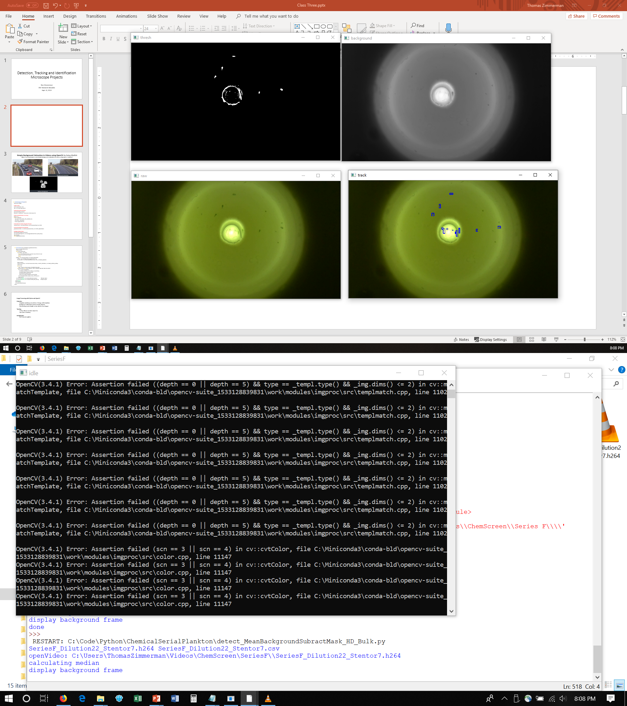
Raw (color)
Background
(Median Filter)
Detection
(Raw – Background)
(grey & threshold)
Tracking
(contours)

Slide 3
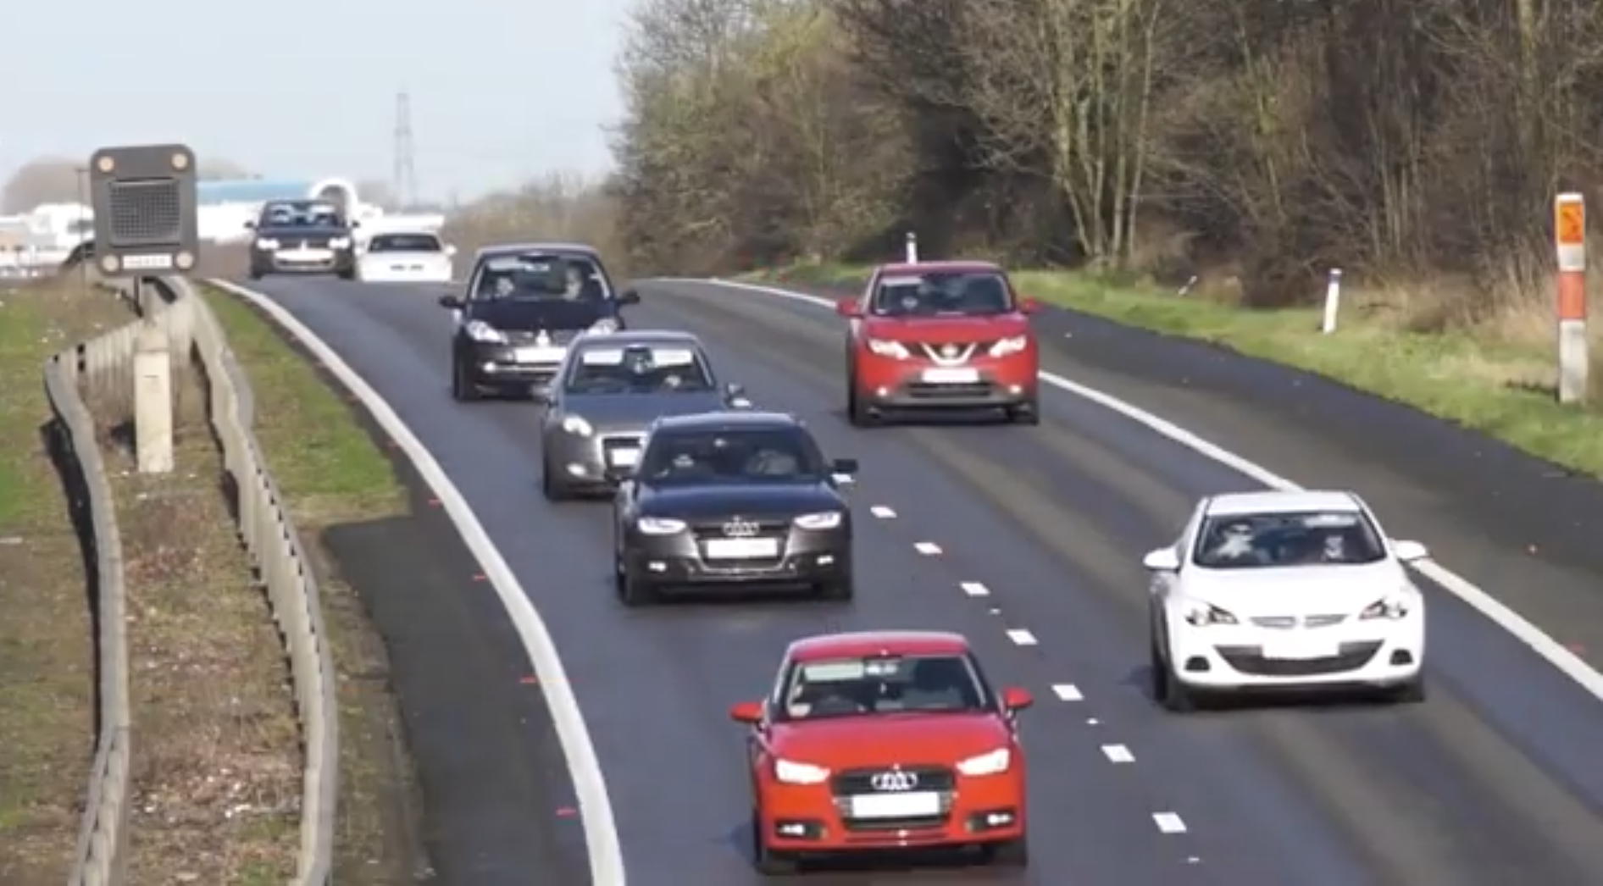
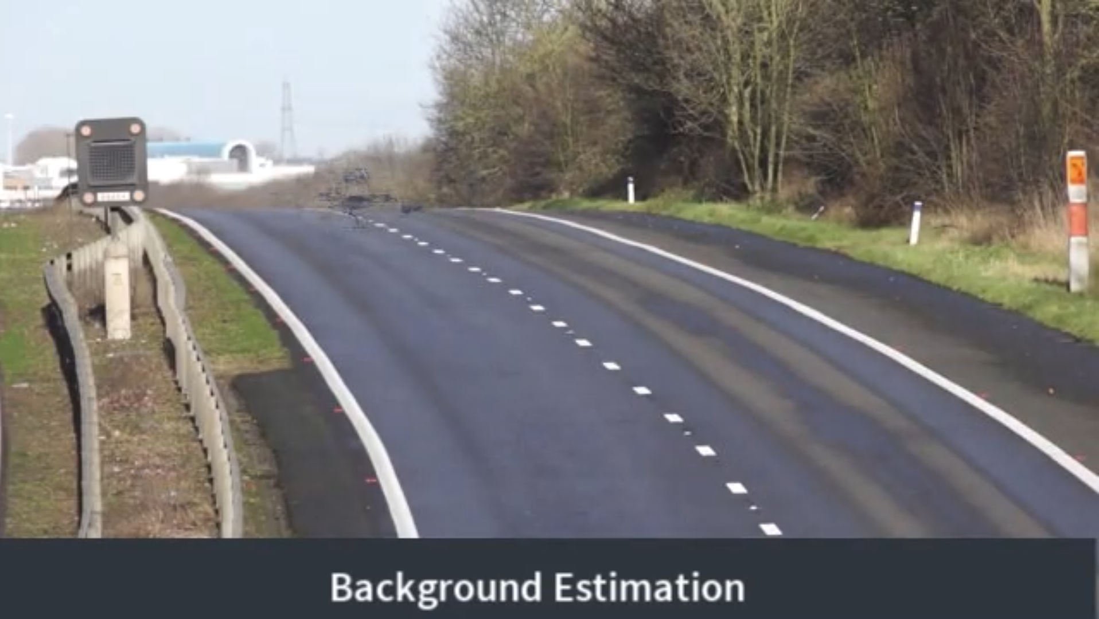
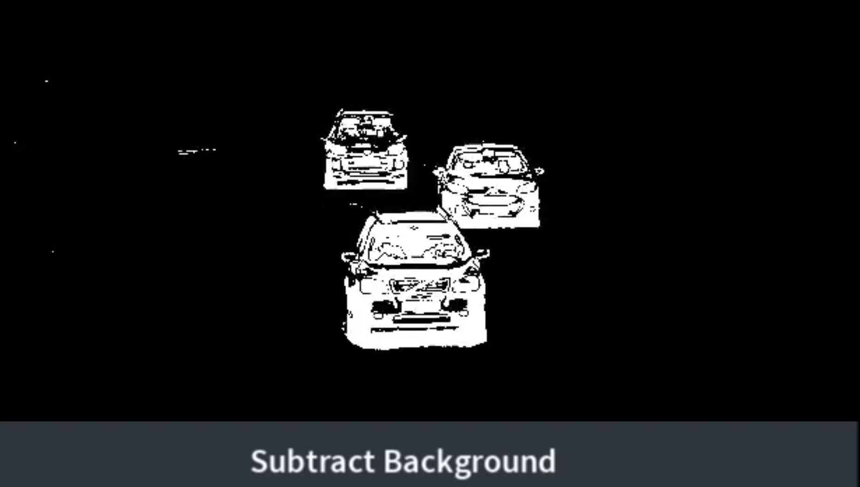
Simple Background Estimation in Videos using OpenCV by Satya Mallick
https://www.learnopencv.com/simple-background-estimation-in-videos-using-opencv-c-python/

Slide 4
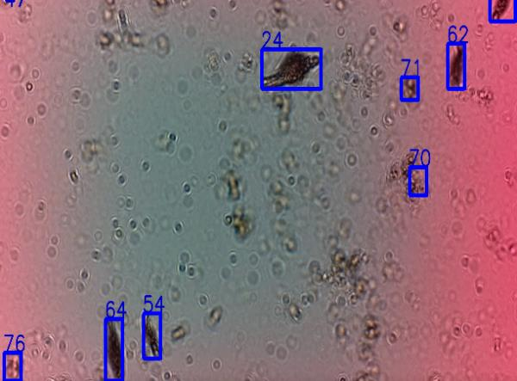
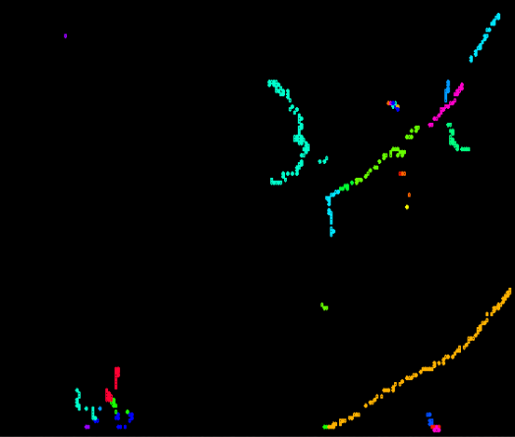
Tracking Multiple Objects
Tracket: A temporal sequence of a single object positions across frame boundaries
Tracklets
6
1
5
4
3
2

Slide 5
Coding Approach to Tracking Multiple Objects
Object Feature:
Match object in current frame to previous frame based on feature (distance, area, aspect ratio, rotation, shape, velocity (magnitude and direction), etc.
What happens when signal drops out so a match with the previous frame can’t be made? Match with wrong object?
Solution: Persistent ID Model (Cam)
Persists and maintains ID across frame.
One object assigned to one Cam
Cam becomes inactive when no object near.
Inactive Cam assigned to object when near and becomes active.
Inactive Cam detected after N frames to prevent “land mine” (assigning dormant ID to actively tracked object)

Slide 6
Case 1 Small movement, all objects far apart
?
B
A
B
A
B
A
A
B
?
C
?
C
C
C
frame 1
frame 2
frame 2
Case 2 Large movement, objects near each other
?
x
A
B
A
B
A
B
?
y
C
C
C
frame 1
frame 2
?
frame 2
z
Case 3 Objects drop out (faulty detection)
?
B
A
B
A
B
A
B
A
B
A
B
?
A
?
A
C
?
C
C
C
?
C
C
C
frame 1
frame 2
frame 2 Identified
frame 3
frame 3

Slide 7
Tracking Challenges
Merge Split Blink

Slide 8
Cam Model of Tracking Objects
“Cam” is like a camera that tracks position of object with persistent memory. Cams keeps track of object position, features and unique identification. In the first frame of the video, each object is assigned a Cam with an ascending ID, starting with zero. In each successive frame, the cam is matched up with the nearest object. If there are more objects than cams, a new cam is created with an ID one greater that the last cam ID. If there are less objects than cams, those extra cams hang around for a few frames and disappear if they get too old, so as not to be erroneously assigned to new objects (the unassigned cams age and “die”). The persistence compensates for when an object temporarly disappears due to detection dropout.
Object
Cam
Frame

Slide 9
Initial Conditions
cam[:,ASSIGNED]=0
obj[:,ASSIGNED]=0
cam[:,ACTIVE]=0
MAX_CAM=20 # number of cams
MAX_DIST= * # max distance an object can move in a frame
MAX_DELTA_AREA= * # max change in object area in a frame
* Must determine empirically by running program and (a) print out and observe reasonable values, (b) plot and observe a histogram or (c) perform a statistical analysis and take the first standard deviation.
nextID=1

Slide 10
3
1
3
1
3
1
2
2
2
Frame 1
Frame 2
Frame 2
Step 1
Assign ID’s to all objects
Step 2
Calculate distance between all Cam’s and Objects.
Step 3
Assign each Object to the ID of the nearest Cam.
3
1
3
1
3
1
2
2
2
Frame 3
Frame 4
Frame 4
Step 4
Repeat Step 2 and 3. If a Cam is not assigned, keep it around for a few frames. Notice Object #3 dropped out.
Step 5
Calculate distance between all Cam’s and Objects. Notice Object #3 reappeared.
Step 5
Assign each Object to the ID of the nearest Cam. Notice Object #3 reappeared and is reassigned.

Slide 11
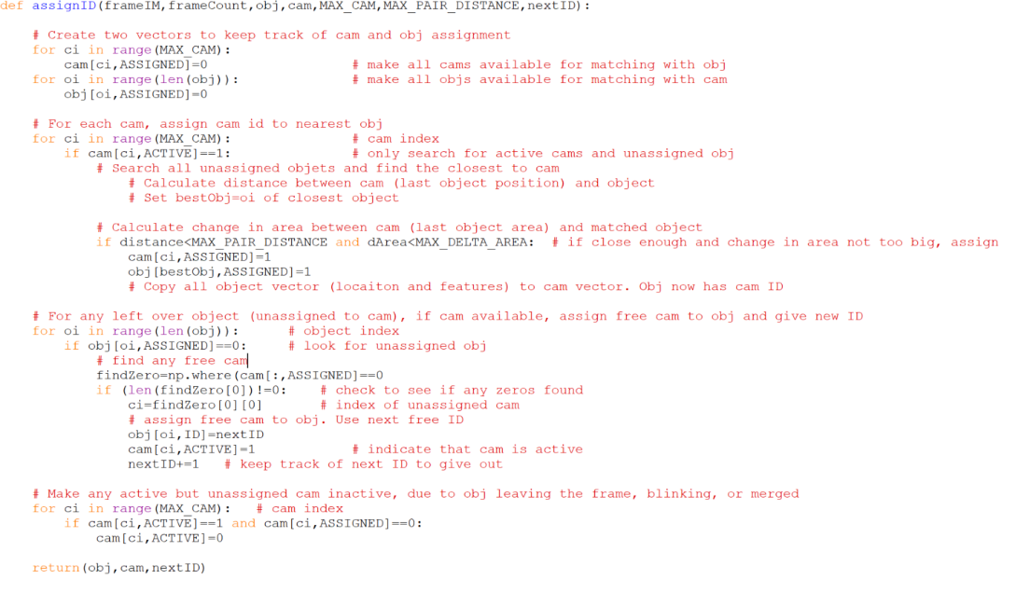
Tracking Multiple Objects: Code Outline using Cams
1
2
3
4
5
6
7
8
9
10
11
12
13
14
15
16
17
18
19
20
21
22
23
24
25
26
27
28
29
30
31
32
33
34
35
36
37

